Slide 1

MINI PROJECT
By: 2021A1R001, 2021A1R006, 2021A1R021

Slide 2
AI GESTURE BASED YOUTUBE CONTROL SYSTEM
PROJECT TITLE 1
PROBLEM STATEMENT: There are various keys and commands for controlling various functions in a YouTube video.
Performing all of these tasks by the same method may get time consuming.

Slide 3

OBJECTIVES
Reduce the need of manually typing the command keys.
Unique hand gestures for various available options.
Time efficient system.

Slide 4
THE SOLUTION
Develop a hand gesture recognition system using computer vision libraries.
Define and recognize a diverse set of hand gestures for controlling YouTube playback.
Integrate the YouTube Data API for seamless communication and control.

Slide 5
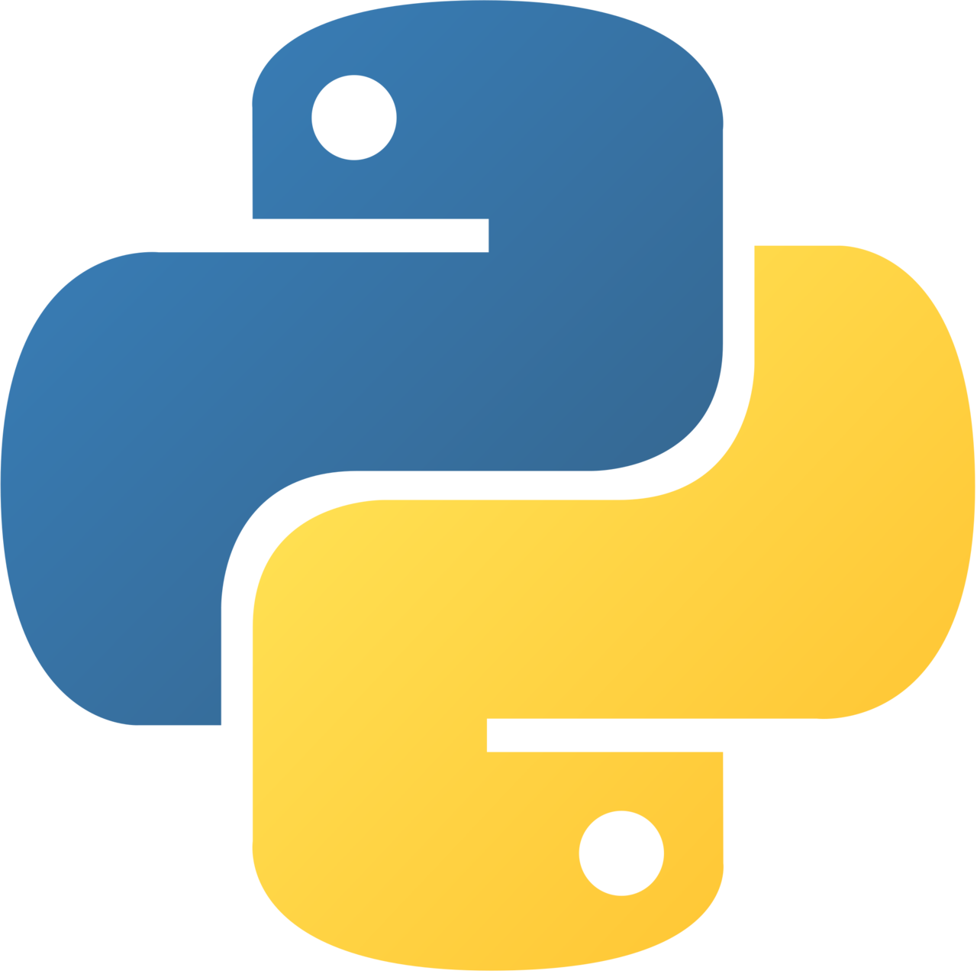
REQUIREMENTS
PYTHON LIBRARIES REQUIRED:
Cvzone
Mediapipe
Numpy
Math
Time
MODEL USED:
Convolutional Neural Network model.
Along with YouTube Data API.

Slide 6
THANK YOU

